Slide 1

“trendAssist” Finance and Business Prediction Program
Cade Wall
Mayur Bhakta
Aaron Turner
Aaron Riggs
Carolyn Wu
Andre Manz
A Project Proposal by Flying Mongeese

Slide 2
Reasons for Developing trendAssist
What trendAssist does
GUI Ease and Simplicity
Security
Overview
Notes:
trendAssist is a business finance and trend prediction program that allows the user to input data over sales made in a day; this data will then be submitted into a database containing financial sales data for every day of the week. It will also allow the user to input data in years past to increase the accuracy of sales predictions; the program will then use this information to generate a new estimation of revenue for that same day of the week in the future and describe requirements needed to hit specific profit margins. This will enable the user (owner or manager) to determine the optimal staffing needed on any given day to support the expected crowd and maximize profits. The most recent year’s data will be weighted higher than the previous year’s data to maintain accuracy and adjust for recent trends.

Slide 3
Reasons for Developing trendAssist
Businesses must manually search for sales data through past sales reports
Hard copy sales reports don’t account for holidays and/or special events such as graduations
Predicting amount of employees scheduled can be challenging

Slide 4
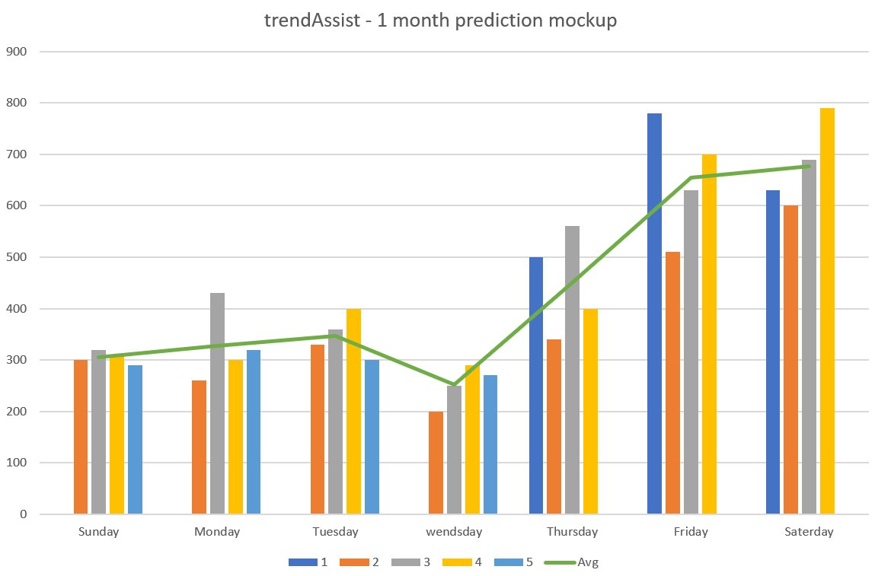
What trendAssist Does
Takes the client’s sales data from the past couple of years
Features sales data forecast generator using weight averages
Allows the client to accurately predict business for any given day and optimize amount of employees scheduled
Account and data security can be implemented through differing authorization levels
Unique, original concept for increasing small business financial efficiency

Slide 5
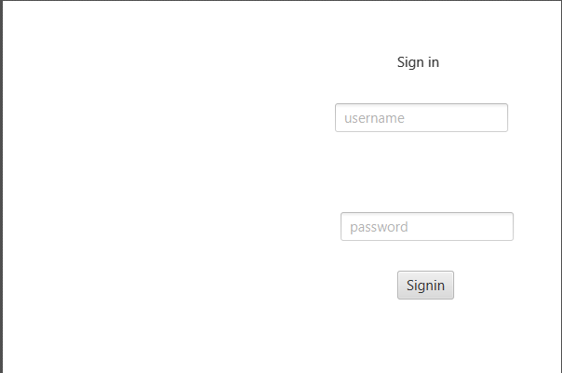
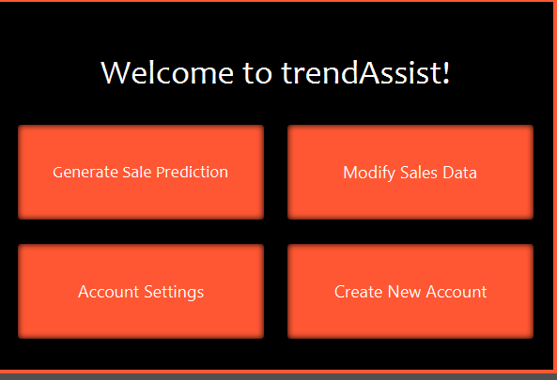
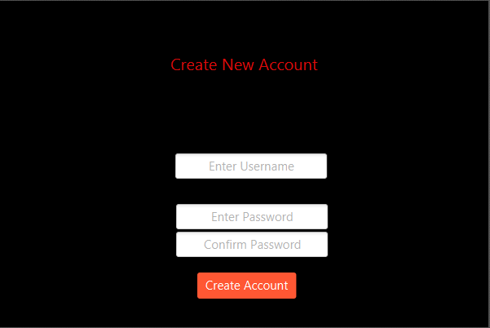
Ease and Simplicity
Tentative Program GUI
with differing color schemes

Slide 6


Keeping Your Data Secure
User password and data will be secured using AES-256 Encryption
Data will not be available to anyone but an authorized user

Slide 7


Q&A

